Slide 1
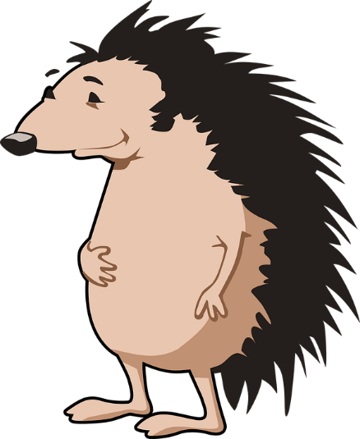
Mirror reflection
Harry the hedgehog looks at himself in a mirror.
?
The mirror has a special name because it is flat.
It is called a plane mirror.

Slide 2
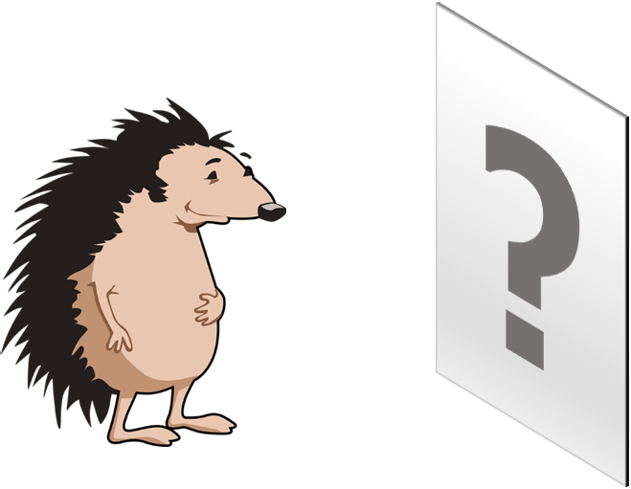
Mirror reflection
How can you describe Harry’s reflection?
I am sure this is right
I think this is right
I think this is wrong
I am sure this is wrong
A
Harry’s reflection is on the mirror
B
Harry’s reflection looks back to front
C
Harry’s reflection is the same size as Harry
D
Everyone looking at the mirror sees the same reflection that Harry sees
Notes:
https://pixabay.com/vectors/hedgehog-animal-spikes-mammal-156172/

